Slide 1

Status of Implementation of Infection Prevention and Control Core Components in Selected Facilities in Kenya
Mary Ndinda John
MPH, BSc. MLS, Cert IPC
Kenya National Public Health Institute

Slide 2
Introduction
Effective infection Prevention and Control (IPC) is critical for reducing healthcare-associated infections (HAI)
Core components of IPC programs provide evidence-based recommendations needed at the national and facility level, to effectively prevent HAI and combat antimicrobial resistance (AMR)
The IPC core components guide countries and health care facilities to establish or strengthen IPC programs and AMR action plans, and improve IPC practices through a feasible, effective, and acceptable framework

Slide 3
Objective
This study aimed to assess the implementation of the IPC core components’ minimum requirements in selected (level 3 to 5) healthcare facilities in Kenya, following IPC sensitization and training of county health management teams

Slide 4
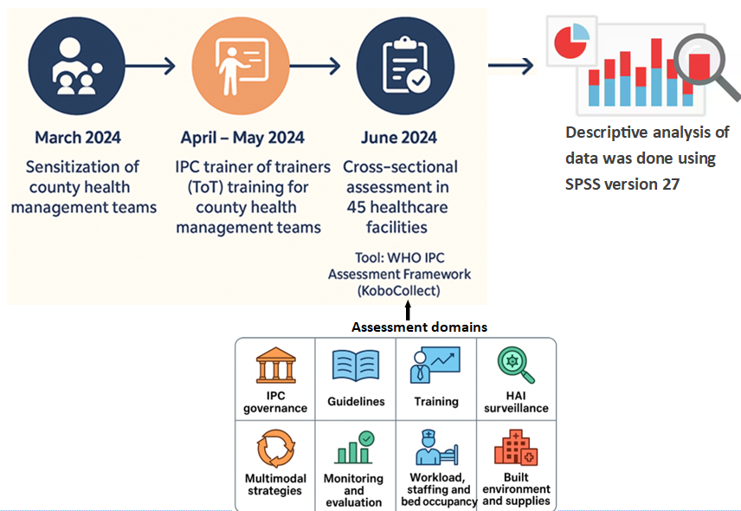
Methods

Slide 5
Results
Facility Ownership
Public healthcare facilities – 84%
Faith-based healthcare facilities - 9%
Private facilities - 7%

Slide 6
Results…

Slide 7
Results…

Slide 8
Results…
Core component 3- IPC education and training
  IPC Trainers of Trainers available in 76% of facilities
  Healthcare worker training conducted in 49% of facilities in the last 6 months
  Support staff training conducted in 40% of facilities in the last 6 months)
  Periodic evaluation of training effectiveness conducted in only 22% of facilities
  Health education for patients & families conducted in 44% of facilities

Slide 9
Results…
Core component 4- HAI surveillance
  Only 27% of facilities have HAI surveillance as a defined IPC component and a responsible person
  Functional microbiology laboratory available in 51% of facilities
  Surgical site infections surveillance conducted in 18% of facilities
  Central line bloodstream infections and Catheter-associated urinary tract infections conducted in 7% of facilities
  Ventilator-associated pneumonia and multidrug-resistant organisms surveillance conducted in 4% of facilities

Slide 10
Results
Core component 5- Multimodal strategies
Core component 6- Monitoring and evaluation of IPC program
Only 40% of the healthcare facilities use multimodal strategies to implement IPC intervention
Monitoring of IPC practices conducted in 24% of facilities
IPC practices monitored:
  Hand hygiene, waste management, and environmental cleaning in 20% of the facilities
  Reprocessing of reusable medical devices in 7% of the facilities
  Consumption/usage of alcohol-based handrub or soap in 9% of the facilities

Slide 11
Results…
Core component 7-Workload staffing and bed occupancy
Core component 8-Built environment, materials and equipment
16% of facilities place patient beds in corridors
53% of facilities ensure at least 1 meter spacing between patient beds
20% of facilities do not allow patient caretakers within wards
20% of facilities experience inconsistent water supply
73% of facilities have PPE consistently available in sufficient quantity
47% of facilities have isolation rooms for infectious disease patients
87% of facilities provide at least 4 toilets/latrines for outpatient settings
89% of facilities meet the standard of at least 1 toilet per 20 users for inpatient settings

Slide 12
Recommendations
Build an economic case for IPC to mobilize for allocation of dedicated IPC budgets at facility and county levels
Adopt/adapt, IPC guidelines (hand hygiene, SSI, device-associated infections, MDRO organisms)
Institutionalize IPC refresher training and integrate training effectiveness assessments
Establish HAI surveillance program with dedicated team
Strengthen microbiology laboratory capacity for AMR and HAI surveillance
Integrate standardized IPC indicators into DHIS2; conduct routine facility IPC practices audits with feedback loops
Provide reliable water supply, functional isolation rooms, and sustained PPE availability

Slide 13
Conclusion
Despite the progress in the establishment of IPC structures, major gaps exist in budget allocation, training evaluation, HAI surveillance, monitoring, and evaluation of the IPC practices, bed occupancy and staffing, and built environment and supplies
Implementing IPC core components' minimum requirements using multimodal strategies is critical to improving compliance with IPC practices and reducing HAIs in Kenyan healthcare facilities

Slide 14
Thank you

